Slide 1
Delegates and Events
Lecturer: Ngo Huy Bien
Software Engineering Department
Faculty of Information Technology
VNUHCM - University of Science
Ho Chi Minh City, Vietnam
nhbien@fit.hcmus.edu.vn

Slide 2

Objectives
To present what is a delegate.
To create delegates.
To present why use delegates.
To write lambda expressions.
To create events.

Slide 3

Contents
Delegates.
Lambda Expressions.
Events.

Slide 4

References
RB Whitaker (2017). The C# Player's Guide. Starbound Software.
Joseph Albahari and Eric Johannsen (2020). C# 8.0 in a Nutshell: The Definitive Reference. O'Reilly Media.
Tom Archer and Andrew Whitechapel (2002). Inside CSharp. Microsoft Corporation.
Per Brinch Hansen (1970). The Nucleus of a Multiprogramming System.

Slide 5
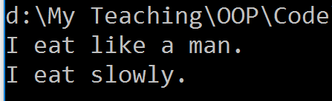
Method Variable [1]
How could we assign a method to a variable and pass it around, just like we’ve done with all of our other types of data?

Slide 6
delegate Type
How could we assign a method to a variable and pass it around, just like we’ve done with all of our other types of data?

Slide 7
What is a Delegate? [2]
Method signature
A delegate (instance) is an object (variable) that holds a method.
A delegate type defines the kind of method that delegate instances can call.
Type
Calling a delegate instance
Declaring a delegate instance

Slide 8
Creating a delegate Instance
Type
Creating a delegate instance

Slide 9


Slide 10


Why Delegates?

Slide 11

Reason 1: Injecting Custom Code [3]

Slide 12
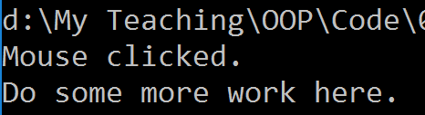
Reason 2: Combining Injected Code
D1
D2
D3
Composed (Multicast) Delegates

Slide 13

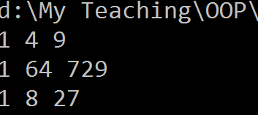
D1 ➠ D2 ≠ D1 + D2 [2]

Slide 14
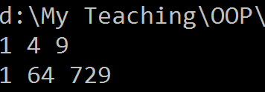
Generic Delegate Types

Slide 15
The Func and Action Delegates
With generic delegates, it becomes possible to write a small set of delegate types that are so general they can work for methods of any return type and any (reasonable) number of arguments.
These delegates are the Func and Action delegates, defined in the System namespace:

Slide 16
Func Example
Why Func and Action Delegates?
– Omitting writing the delegate type, which includes specifying the return and argument types.

Slide 18
Lambda Expression
A lambda expression is an unnamed method written in place of a delegate instance.
A lambda expression has the following form:
(parameters) => expression-or-statement-block

Slide 19
Lambda Operator: =>
https://docs.microsoft.com/en-us/dotnet/csharp/language-reference/operators/lambda-operator
The => token is called the lambda operator.
It is used in lambda expressions to separate the input variables on the left side from the lambda body on the right side.

Slide 20
Lambda Expression with One Parameter
You can omit the parentheses () if and only if there is exactly one parameter of an inferable type.
If we only have one statement and want to return this, then we can omit the curly brackets {} and skip the return keyword.

Slide 21
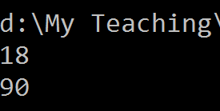
Capturing Outer Variables
A lambda expression can reference the local variables and parameters of the method in which it’s defined (outer variables).
Outer variables referenced by a lambda expression are called captured variables.
A lambda expression that captures variables is called a closure.
Captured variables are evaluated when the delegate is actually invoked, not when the variables were captured.

Slide 22
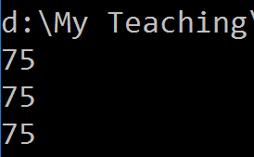
Capturing Iteration Variables
When you capture the iteration variable of a for loop, C# treats that variable as though it was declared outside the loop.
This means that the same variable is captured in each iteration.

Slide 23

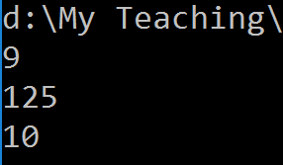
How Lambda Expressions Work?
The compiler immediately converts the lambda expression to either:
A delegate instance.
An expression tree, of type Expression<TDelegate>, representing the code inside the lambda expression in a traversable object model. This allows the lambda expression to be interpreted later at runtime. What is an expression tree?

Slide 24

Why Lambda Expressions?

Slide 26
Publisher and Subscriber
The broadcaster or publisher is a type that contains a delegate field. The broadcaster decides when to broadcast, by invoking the delegate.
The subscribers are the method target recipients. A subscriber decides when to start and stop listening, by calling += and −= on the broadcaster’s delegate.

Slide 27
event Keyword
An event is a construct that exposes just the subset of delegate features required for the broadcaster/subscriber model.
Code within the MyButton type has full access to ClickHandler and can treat it as a delegate.
Code outside of MyButton can only perform += and −= operations on the ClickHandler delegate (event).

Slide 28
Event and Subscriber Relationship
Windows
OnClick
Button
OnMove
Panel

Slide 29
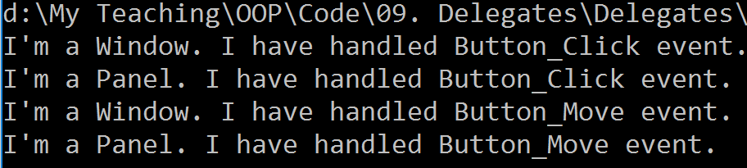
Example

Slide 30
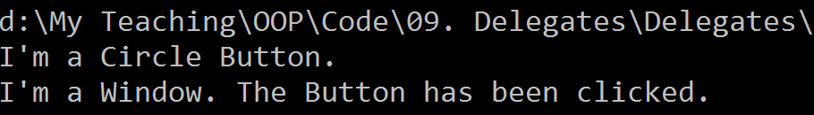
Event and Inheritance

Slide 31

Thank You & See You Again

